Slide 1
PV fed single phase grid connected inverter
Under the supervision of Dr. R.K. Singh Sir

Slide 2
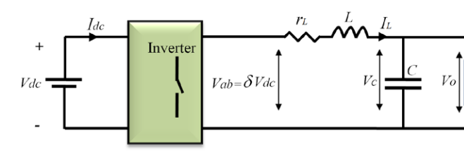
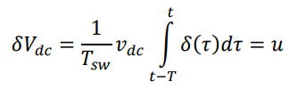

Average model of Inverter
Here the inverter is modelled and Inverter voltage can be derived as :
$$V_{dc } is equal to V_{mpp} of PV array.$$

Slide 3
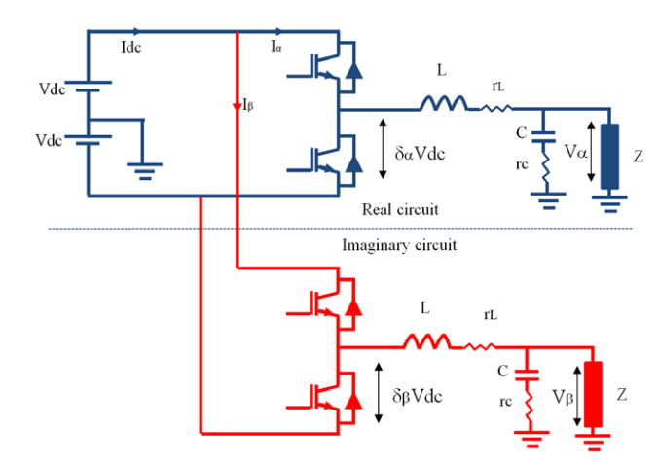

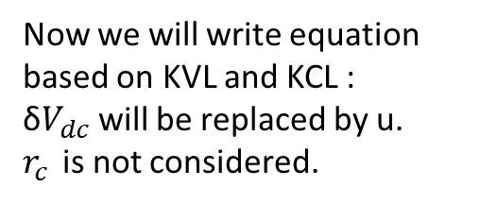



Average model of Inverter in α-β domain
Now we will write equation based on KVL and KCL :
δ$V_{dc}$ will be replaced by u.
$r_{c }$is not considered.
$i_{Lα}$
$$i_{gα}$$
$$u_{α}=Ldi_{Lα}+ r_{L}i_{Lα}+v_{α}$$
$i_{Lα}$ - $i_{gα}$ = C$\frac{dv_{α}}{dt}$
$$i_{gβ}$$
$$u_{β}=Ldi_{Lβ}+ r_{L}i_{Lβ}+v_{β}$$
$i_{Lβ}$
$i_{Lβ}$ - $i_{gβ}$ = C$\frac{dv_{β}}{dt}$

Slide 4




Equations in d – q domain
Now, the equation are transformed to d-q domain.
$$\frac{di_{Ld}}{dt}= \frac{u_{d}}{L} −\frac{v_{d} }{L}− \frac{r}{L}i_{Ld}+ ωi_{Lq}$$
(i)
$$\frac{dv_{d}}{dt}= \frac{i_{Ld}}{C} −\frac{i_{gd}}{C}+ωv_{q}$$
(ii)
$$\frac{di_{Lq}}{dt}= \frac{u_{q}}{L} −\frac{v_{q} }{L}− \frac{r}{L} − ωi_{Ld}$$
(iii)
$$\frac{dv_{q}}{dt}= \frac{i_{Lq}}{C} −\frac{i_{gq}}{C}− ωv_{d}$$
(iv)

Slide 5
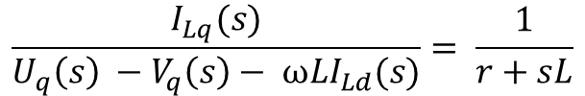

Transfer Function for Current Controller
After transforming Equation (i) & (iii) in Laplace domain, we got the following transfer function.
D – axis Controller Transfer function :
$$\frac{I_{Ld}(s)}{U_{d}\left(s\right) −V_{d}\left(s\right)+ ωLI_{Lq}(s)}= \frac{1}{r+sL}$$
Q – axis Controller Transfer function :
$$\frac{I_{Lq}(s)}{U_{q}\left(s\right) −V_{q}\left(s\right)− ωLI_{Ld}(s)}= \frac{1}{r+sL}$$

Slide 6












Design of LC Filter
Model Specifications :
$$V_{grid}=230 V (rms)$$
$$V_{mpp}= V_{dc}=450 V$$
$$V_{oc}=573 V$$
$$Power=513 W$$
$$freq=50 Hz$$
$$f_{sw}=20 KHz$$
$$r=1e−3 Ω$$
$$Current ripple=20\%$$
$$∆i=0.2∗I_{L}$$
Inverter side Inductance Calculation :
$$f_{c}=\frac{f_{sw}}{10}$$
Capacitance Calculation :
$$L= \frac{V_{dc}}{4∗∆i∗f_{sw}}= 8.9 mH$$
$$ω_{c}=\frac{1}{\sqrt{LC}}$$
$$C= \frac{1}{L∗{ω_{c}}^{2}}=0.71 μF$$

Slide 7







Current Controller Design
Open Loop Transfer Function :
$$G\left(s\right)= K_{p}+ \frac{K_{i}}{s}$$
;
$$H\left(s\right)= \frac{1}{r+sL}$$
;
$$OLTF=G\left(s\right)H\left(s\right)= \frac{({sK}_{p}+K_{i})}{s(r+sL)}$$
Using Pole-zero cancellation :
$$K_{p }=2πf_{c}L$$
$$K_{i}= \frac{K_{p}∗r}{L}$$
For weak grid, we have grid side Inductance($L_{g})$ much higher than inverter side Inductance($L$), so under the consideration of Grid side inductance also, Controller design parameters can be adapted as :
$$K_{pnew}=K_{p}∗\frac{(L+L_{g})}{L}$$
$$K_{inew}=K_{i}∗\frac{(L+L_{g})}{L}$$

Slide 8
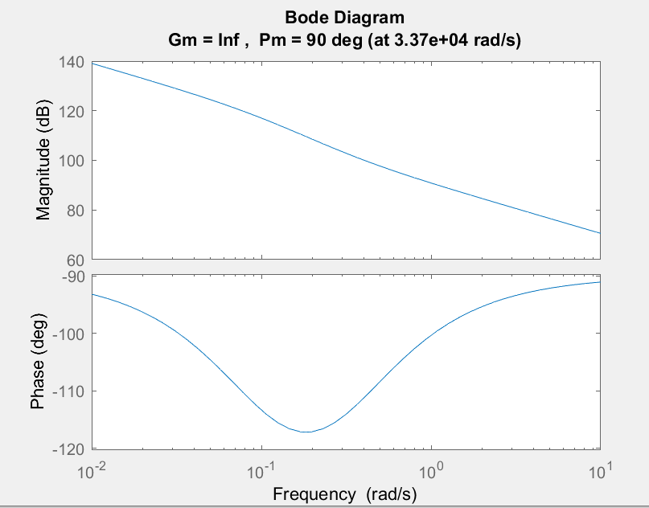

Bode Plot For Current Controller
$$OLTF=G\left(s\right)H\left(s\right)= \frac{({sK}_{p}+K_{i})}{s(r+sL)}$$
Bode Plot for OLTF

Slide 9
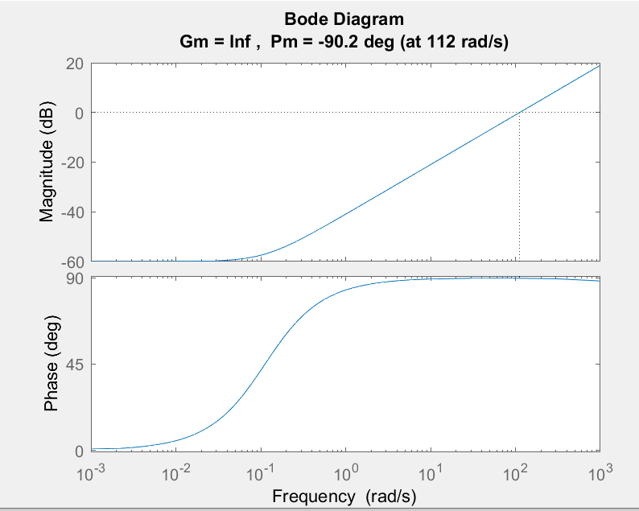
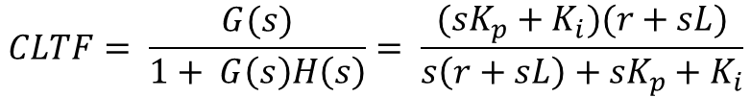
Bode Plot For Current Controller
$$CLTF= \frac{G(s)}{1+ G\left(s\right)H\left(s\right)}= \frac{({sK}_{p}+K_{i})(r+sL)}{s\left(r+sL\right)+{sK}_{p}+K_{i}}$$
Bode Plot for CLTF

Slide 10
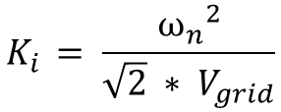

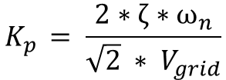
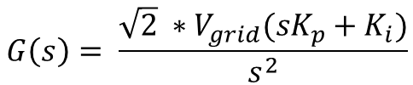


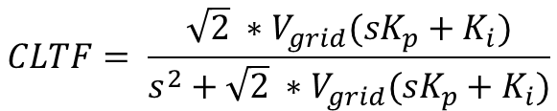
PLL Controller Design
$$G\left(s\right)= \frac{\sqrt{2} ∗V_{grid}({sK}_{p}+K_{i})}{s^{2}}$$
$$H\left(s\right)=1$$
$$CLTF= \frac{\sqrt{2} ∗V_{grid}({sK}_{p}+K_{i})}{s^{2}+\sqrt{2} ∗V_{grid}({sK}_{p}+K_{i})}$$
This is a 2nd order transfer function, so by limiting maximum overshoot to 4%, we have
$$ζ=0.7$$
$$ω_{n}=50 rad/s$$
Now, controller parameters can be derived as :
$$K_{p }= \frac{2∗ζ∗ω_{n}}{\sqrt{2} ∗ V_{grid}}$$
$$K_{i }= \frac{{ω_{n}}^{2}}{\sqrt{2} ∗ V_{grid}}$$

Slide 11
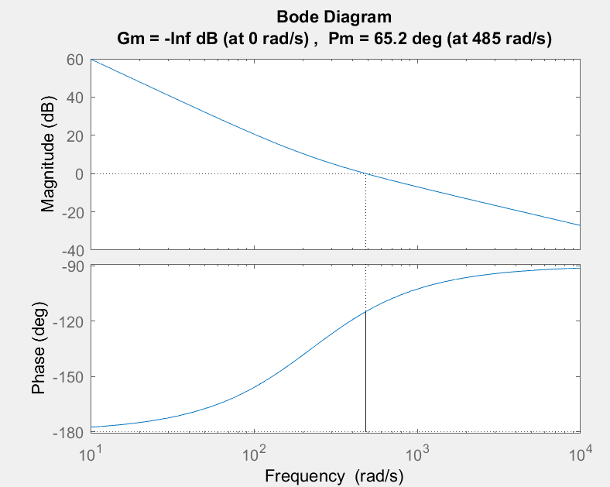

Bode Plot For PLL Controller
$$OLTF=G\left(s\right)H\left(s\right)= \frac{\sqrt{2} ∗V_{grid}({sK}_{p}+K_{i})}{s^{2}}$$
Bode Plot for OLTF

Slide 12
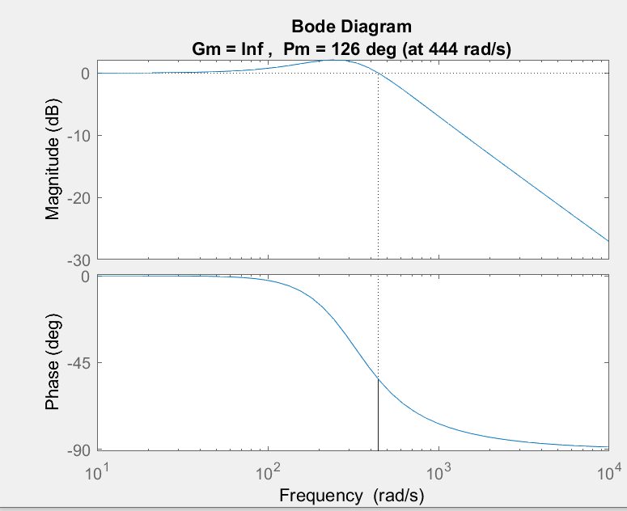
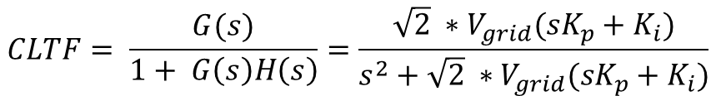
Bode Plot For PLL Controller
$$CLTF= \frac{G(s)}{1+ G\left(s\right)H\left(s\right)}=\frac{\sqrt{2} ∗V_{grid}({sK}_{p}+K_{i})}{s^{2}+\sqrt{2} ∗V_{grid}({sK}_{p}+K_{i})}$$
Bode Plot for CLTF

Slide 13
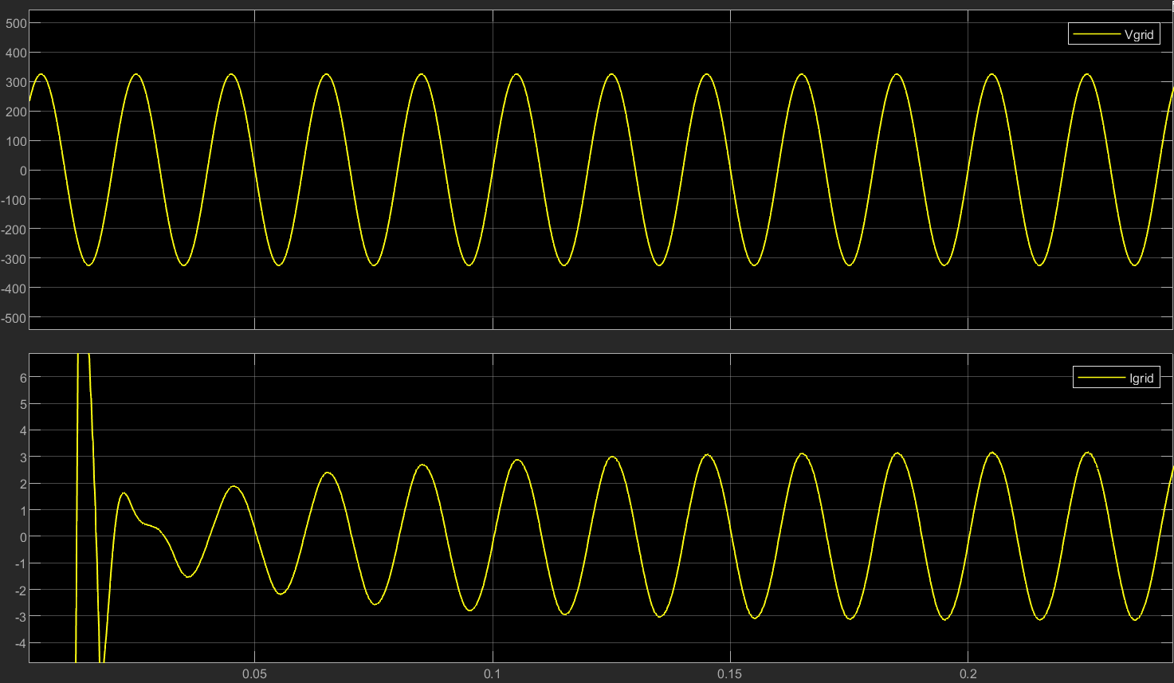
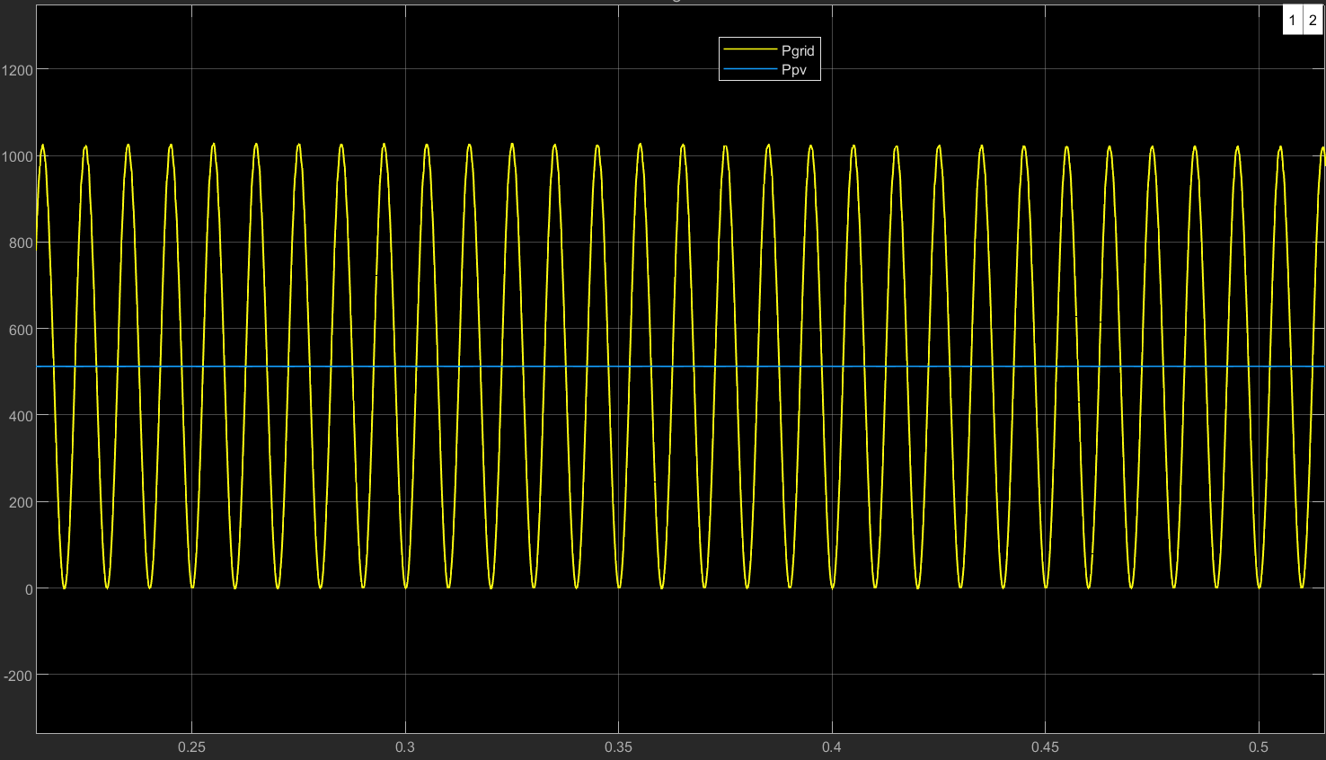
Results
Vgrid and Igrid
Pgrid and Ppv

Slide 14
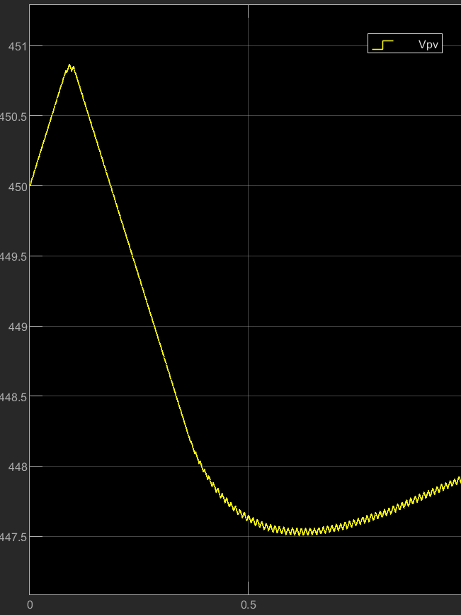
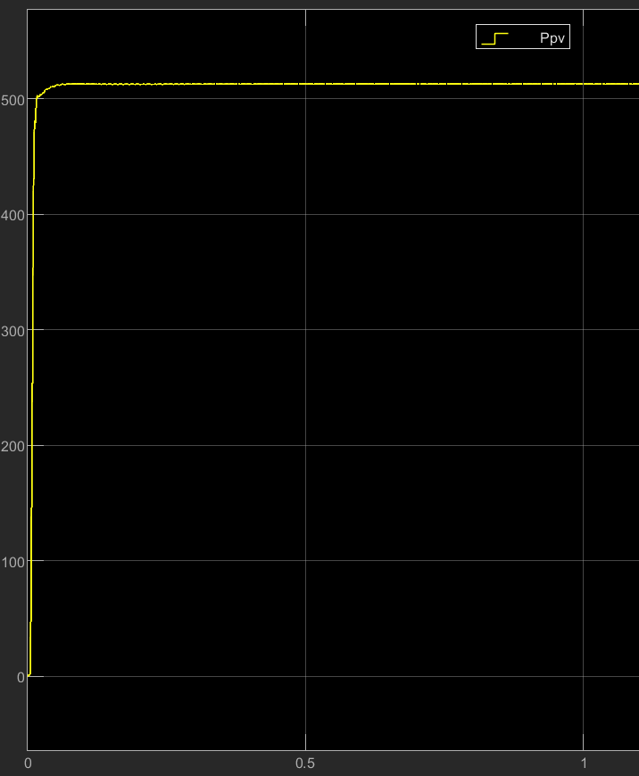
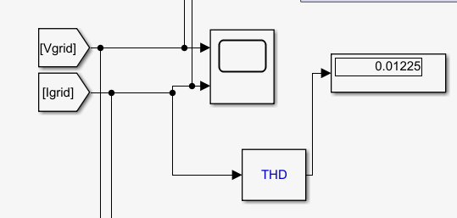
Results Contd.
THD of Igrid
Vpv
Ppv

Slide 15
Thank You !
Presented by – Harsh Gupta
EEE(IDD)
Part - 02

